Slide 1
Results – The good, the bad and the ugly

Slide 2
Overall – Really please with you all!
Core Exams: Ranged from E up to B grades
ESP was the strongest point: Ranged from C up to A* grade
Overall was really positive: Ranged from D up to B grade.
Literally couldn’t have asked for more from you all!

Slide 3
Core Exams grade boundaries
 | Max Mark | A* | A | B | C | D | E | U
RAW | 200 | 144 | 123 | 102 | 81 (-1) | 60 (-2) | 40 (-2) | 0
UMS | 240 | 216 | 192 | 168 | 144 | 120 | 96 | 0

Slide 4
ESP grade Boundaries
 | Max Mark | A* | A | B | C | D | E | U
RAW | 100 | 80 (+3) | 69 (+3) | 58 (+3) | 47 (+3) | 36 (+3) | 25 (+3) | 0
UMS | 120 | 108 | 96 | 84 | 72 | 60 | 48 | 0

Slide 5
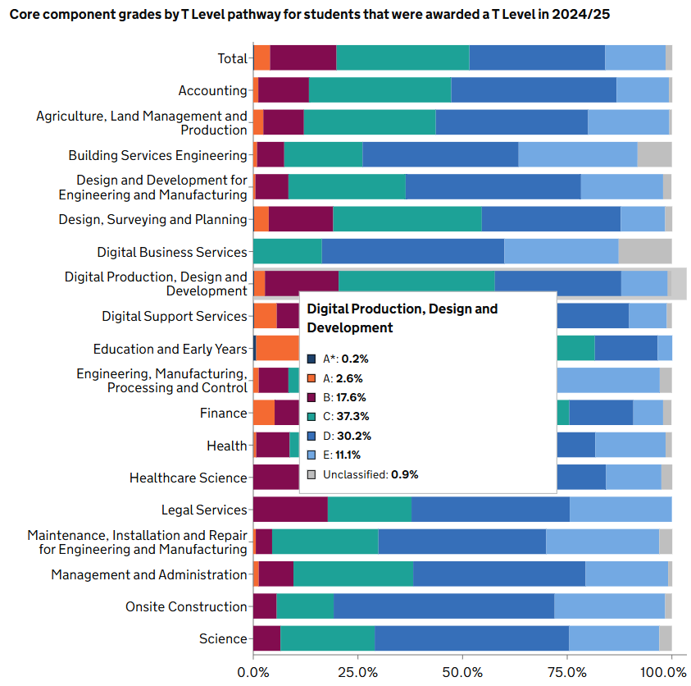
National Picture

Slide 6
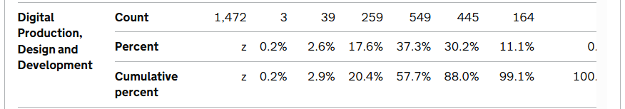

Slide 7
Where do we sit against national?
Of the 8 of you taking core last year?
We have:
  4 x Grade D (31% of our cohort)
  6 x Grade C (46% of our cohort)
  2 x Grade B (15% of our cohort)
  This means, we are largely inline with national picture!
  Nationally, the average Female grade was a C and the Male grade was a D.

Slide 8
Where does it leave you for this year?
 | Occupational Specialism
CORE |  | Distinction | Merit | Pass
 | A* | Distinction * | Distinction | Distinction
 | A | Distinction | Distinction | Merit
 | B | Distinction | Merit | Merit
 | C | Distinction | Merit | Pass
 | D | Merit | Merit | Pass
 | E | Merit | Pass | Pass

Slide 9
Re-sit options then
Core Exam – You will have to sit BOTH papers, with limited or no specialist teaching
ESP – Not worth it really as you did so well, but also with limited or no specialist teaching
College will pay for one re-sit

